Slide 1
Bayesian Network
Bayesian Reasoning
Iftekhar Mahmud Towhid

Slide 2
Recommended
To get a visual understanding of this topic, watch the following videos:
  (123) The Bayesian Trap – YouTube
  Bayes theorem, the geometry of changing beliefs – YouTube
  Bayes' Theorem - The Simplest Case (youtube.com)

Slide 3
Bayesian Reasoning
Practical AI systems have to cope with uncertainty — that is, they have to deal with incomplete evidence leading to beliefs that fall short of knowledge, with fallible conclusions and the need to recover from error, called non-monotonic reasoning.
General-purpose AI need to be able to reason probabilistically, what we call here Bayesian reasoning.

Slide 4
Bayesian Reasoning
There are at least three distinct forms of uncertainty which an intelligent system operating in anything like our world shall need to cope with:
  Ignorance: The limits of our knowledge lead us to be uncertain about many things. Does our poker opponent have a flush or is she bluffing?
  Physical randomness or indeterminism: Even if we know everything that we might care to investigate about a coin and how we impart spin to it when we toss it, there will remain an inescapable degree of uncertainty about whether it will land heads or tails when we toss it. A die-hard determinist might claim otherwise, that some unimagined amount of detailed investigation might someday reveal which way the coin will fall; but such a view is for the foreseeable future a mere act of scientistic faith. We are all practical indeterminists.
  Vagueness: Many of the predicates we employ appear to be vague. It is unclear whether to classify a dog as a spaniel or not, a human as brave or not, a thought as knowledge or opinion.

Slide 5
Bayes Rule Refresher
Conditional Probability: If A and B are dependent variables, then probability of event A occurring given event B already occurred is :
  P(A|B) = P(A ∩ B) / P(B)
Bayesian Approach:
  Single hypothesis H, single event E
  P(H|E) = (P(E|H) * P(H)) / P(E)
  or,
  P(H|E) = (P(E|H) * P(H) /
  (P(E|H) * P(H) + P(E| ¬ H) * P(¬ H) )

Slide 6
Bayes Example: Diagnosing Meningitis
Suppose we know that
  Stiff neck is a symptom in 50% of meningitis cases
  Meningitis (m) occurs in 1/50,000 patients
  Stiff neck (s) occurs in 1/20 patients
Then
  P(s|m) = 0.5, P(m) = 1/50000, P(s) = 1/20
  P(m|s) = (P(s|m) P(m))/P(s)
  = (0.5 x 1/50000) / 1/20 = .0002
So, we expect that one in 5000 patients with a stiff neck to have meningitis.

Slide 7
Bayes Rule Example 2: Cancer Test
We have some probabilities of cancer tests results form empirical data. The test procedure is not 100% perfect, thus we get some incorrect results.
  Suppose the following probabilities are given:
    P(Test+|Cancer) = 0.9
    P(Test-|Cancer) = 0.1 [False negative]
    P(Test+|No cancer) = 0.001 [False positive]
    P(Test-|No cancer) = 0.999
    P(Cancer) = 0.0001 [Cancer happens in 1 in 10000 people]
  We want to know if a patient is tested positive for cancer, what is the actual probability that they have cancer?

Slide 8
Solution
From Bayes’ rule, we know that:
  P(Cancer|Test+) = (P(Test+|Cancer) ⋅ P(Cancer)) / P(Test+)
First, we find P(Test+):
  P(Test+) = P(Test+|Cancer) ⋅ P(Cancer) + P(Test+|No cancer) * P(No cancer)
  = 0.9 × .0001 + .01 × (1 – .0001)
  = 0.0010899
Now we have all the necessary information:
  P(Test+|Cancer) = 0.9, P(Cancer) = .0001, P(Test+) = 0.0010899
  Thus, P(Cancer|Test+) = (0.9 × .0001) / 0.0010899
  = ~0.0826
Thus, we can say that, for the given probabilities, if a patient is tested positive for cancer, the probability that they really have cancer is only ~8%.

Slide 9
Belief Update
One on the useful aspects of Bayes’ rule is that we can update beliefs.
  Our previous belief about an event is called prior belief.
  Our updated belief after observing an event is called posterior belief.
For example, continuing from the previous example of Cancer test, if the patient now goes through a second test and tests positive again, what is probability that they really have cancer?
  It still is not 100%, as there is still a chance that the second test is also false positive.

Slide 10
Belief Update
In this case, we will use the same formula to find P(Cancer|Test+) as before.
However, now we know, given the results of previous test (Test 1), the patient have probability 0.0826 of having cancer, instead of our prior belief of 0.0001.
Thus, after test 2,
  P(Cancer) = 0.0826, P(No cancer) = 1 – 0.0826 = 0.9174
  P(Test+) = P(Test+|Cancer) ⋅ P(Cancer) + P(Test+|No cancer) ⋅ P(No cancer)
  = 0.9 × 0.0826 + 0.001 × 0.9174
  = 0.0753
  P(Cancer|Test+) = (P(Test+|Cancer) ⋅ P(Cancer)) / P(Test+)
  = (0.9 × 0.0826) / 0.0753
  = ~0.987
Thus, we can say that there is now 98% chance that the patient have cancer after the second test coming positive.
To view a visual representation of a similar case, watch this Veritasium video: (123) The Bayesian Trap - YouTube

Slide 11
Bayesian Network
A Bayesian network (BN) is a probabilistic graphical model for representing knowledge about an uncertain domain where each node corresponds to a random variable and each edge represents the conditional probability for the corresponding random variables.
This allows us to reason or infer about the domain.
It is also called a Bayes network, belief network, decision network, or Bayesian model.
Bayesian networks are ideal for taking an event that occurred and predicting the likelihood that any one of several possible known causes was the contributing factor (For example, Medical symptom diagnosis).
Real world applications are probabilistic in nature, and to represent the relationship between multiple events, we need a Bayesian network. It can also be used in various tasks including prediction, anomaly detection, diagnostics, automated insight, reasoning, time series prediction, and decision making under uncertainty.

Slide 12
Graphical Model
Formally, Bayesian networks are directed acyclic graphs (DAGs).
Nodes represent variables in the Bayesian sense: they may be observable quantities, latent variables, unknown parameters or hypotheses.
Each edge represents a direct conditional dependency. Any pair of nodes that are not connected (i.e. no path connects one node to the other) represent variables that are conditionally independent of each other.
Each node is associated with a probability function that takes, as input, a particular set of values for the node's parent variables and gives (as output) the probability (or probability distribution, if applicable) of the variable represented by the node. For example, if m parent nodes represent m Boolean variables, then the probability function could be represented by a table of 2^{m} entries, one entry for each of the 2^{m} possible parent combinations.
Similar ideas may be applied to undirected, and possibly cyclic, graphs such as Markov networks.

Slide 13
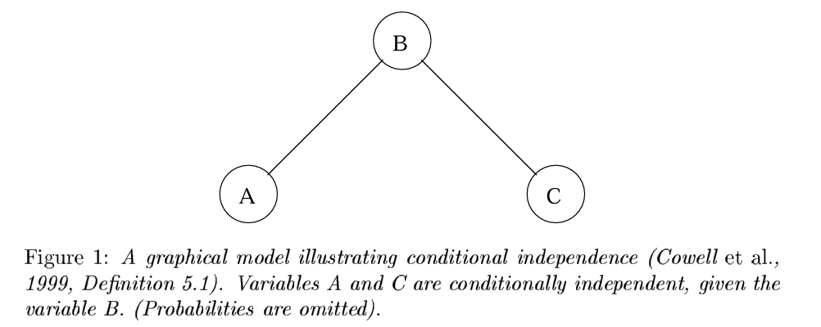
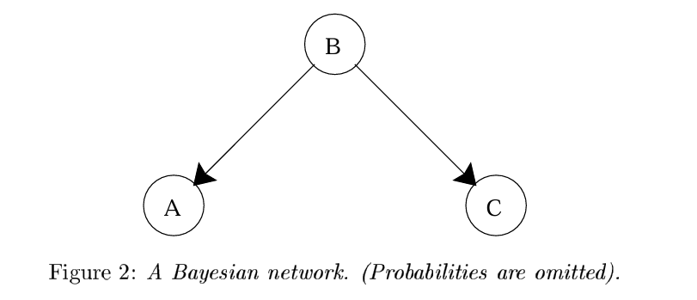
Computational Model
Computes posterior probabilities given evidence about some nodes
Exploits probabilistic independence for efficient computation

Slide 14
Building Bayesian Network
Bayesian Network can be used for building models from data and expert opinions, and it consists of two parts:
  Directed Acyclic Graph
  Table of conditional probabilities.
The generalized form of Bayesian network that represents and solve decision problems under uncertain knowledge is known as an Influence diagram.

Slide 15
Bayesian Network Model
The following figure illustrates a simple Bayesian network.
  3 nodes: A, B, C
  Set of Edges E = {(B, A), (B, C)}
  Directed graph
  Acyclic graph
  A and C are conditionally independent of each other. Thus, P(A|B, C) = P(A|B)
  Similarly, P(C|A, B) = P(C|B)

Slide 16
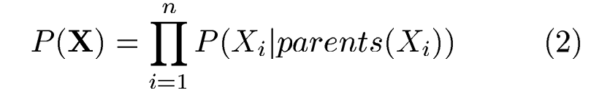
Bayesian Network Model
  The edges in the Bayesian network encode a particular factorization of the joint distribution. In this example, the joint distribution of all the variables, as factorized by this Bayesian network is,
  In general, given nodes X = X₁, X₂, . . . , Xn, the joint probability function for any of the Bayesian Network is,
    That is, the joint probability of all the variables is the product of the probabilities of each variable given its parents values. This shows the meaning of directed edges: they indicate which other variables a given variable is conditioned upon.
    (Explanation on a later slide)

Slide 17
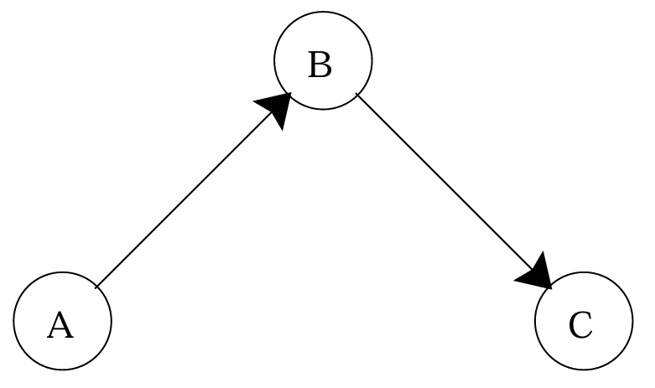
Bayesian Network Model
  The edges in Bayesian networks are sometimes looked at as causal connections where each parent node causes an effect on its children.
  The joint probability represented by one set of edges can equally be represented by another set. For example, using Bayes’ rule, the joint probability from (1) becomes:
A Bayesian network that represents the same joint probability as the figure on left

Slide 18
Bayesian network components
The Bayesian network has mainly two components:
  Causal Component
  Actual numbers
Each node in the Bayesian network has conditional probability distribution P(X_{i} |parents(X_{i}) ), which determines the effect of the parents on that node.
Bayesian network is based on Joint probability distribution and conditional probability.
So, let's first understand the joint probability distribution:

Slide 19
Joint probability distribution
If we have variables x₁, x₂, x₃,....., x_{n}, then the probabilities of a different combination of x₁, x₂, x₃.. x_{n}, are known as Joint probability distribution.
P(x₁, x₂, x₃,....., x_{n}), it can be written as the following way in terms of the joint probability distribution.
  = P(x₁| x₂, x₃,....., x_{n})P(x₂, x₃,....., x_{n})
  = P(x₁| x₂, x₃,....., x_{n})P(x₂|x₃,....., x_{n})....P(x_{n-1}|x_{n})P(x_{n}).
In general, for each variable X_{i}, we can write the equation as:

Slide 20
Explanation of Bayesian network
Let's understand the Bayesian network through an example by creating a directed acyclic graph:
Example: Harry installed a new burglar alarm at his home to detect burglary. The alarm reliably responds at detecting a burglary but also responds for minor earthquakes. Harry has two neighbors David and Sophia, who have taken a responsibility to inform Harry at work when they hear the alarm. David always calls Harry when he hears the alarm, but sometimes he got confused with the phone ringing and calls at that time too. On the other hand, Sophia likes to listen to high music, so sometimes she misses to hear the alarm. Here we would like to compute the probability of Burglary Alarm.

Slide 21
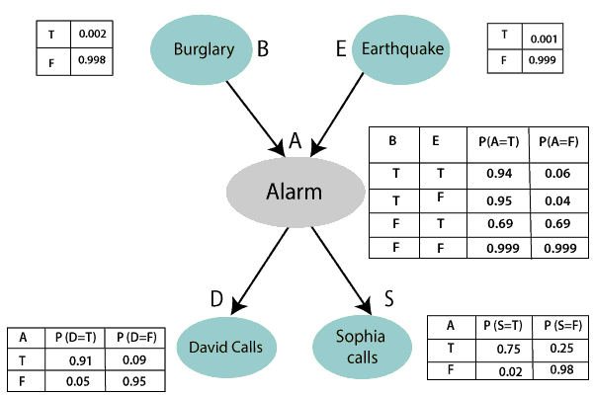
Problem
Calculate the probability that alarm has sounded, but there is neither a burglary, nor an earthquake occurred, and David and Sophia both called the Harry.

Slide 22
Solution
The Bayesian network for the presented problem is given below. The network structure is showing that burglary and earthquake is the parent node of the alarm and directly affecting the probability of alarm's going off, but David and Sophia's calls depend on alarm probability.
The network is representing that our assumptions do not directly perceive the burglary and also do not notice the minor earthquake, and they also not confer before calling.
The conditional distributions for each node are given as conditional probabilities table or CPT.
Each row in the CPT must be sum to 1 because all the entries in the table represent an exhaustive set of cases for the variable.
In CPT, a boolean variable with k boolean parents contains 2^{k} probabilities. Hence, if there are two parents, then CPT will contain 4 probability values

Slide 23
Variables
List of all events occurring in this network:
  Burglary (B)
  Earthquake(E)
  Alarm(A)
  David Calls(D)
  Sophia calls(S)

Slide 24
Joint probability distribution
We can write the events of problem statement in the form of probability: P(D, S, A, B, E), can rewrite the above probability statement using joint probability distribution:
  P(D, S, A, B, E) = P(D|S, A, B, E) ⋅ P(S, A, B, E)
  = P(D|S, A, B, E) ⋅ P(S|A, B, E) ⋅ P(A, B, E)
  = P(D|A) ⋅ P ( S|A, B, E) ⋅ P( A, B, E)
  = P(D|A) ⋅ P( S|A) ⋅ P(A|B, E) ⋅ P(B, E)
  = P(D|A ) ⋅ P(S|A) ⋅ P(A|B, E) ⋅ P(B|E) ⋅ P(E)
  = P(D|A ) ⋅ P(S|A) ⋅ P(A|B, E) ⋅ P(B) ⋅ P(E)

Slide 25
Observed probabilities
The question is how to we get the probabilities.
Probabilities are determined by observing the frequencies of events.
In this case, to determine the probabilities of burglary and earthquake, we collect data about how often burglaries and earthquakes happen in the area.
For example, In a Symptom Diagnosis System, data is collected on how often a symptom leads to a particular diagnosis.
In a Spam detector system, how often a word or phrase is associated with spam mails.
In weather prediction system, how often overcast condition leads to a rain shower.

Slide 26
Observed probabilities
Suppose the following values are given for the problem:
  The observed probabilities for the Burglary and earthquake components are:
    P(B = True) = 0.002, which is the probability of burglary.
    P(B = False) = 0.998, which is the probability of no burglary.
    P(E = True) = 0.001, which is the probability of a minor earthquake
    P(E = False) = 0.999, Which is the probability that an earthquake not occurred.

Slide 27
Conditional probabilities
The conditional probabilities are provided as per the below tables:
Conditional probability table for Alarm A:
  The Conditional probability of Alarm A depends on Burglar and earthquake:
B | E | P(A= True) | P(A= False)
True | True | 0.94 | 0.06
True | False | 0.95 | 0.04
False | True | 0.31 | 0.69
False | False | 0.001 | 0.999

Slide 28
Conditional probabilities
Conditional probability table for David Calls:
  The Conditional probability of David that he will call depends on the probability of Alarm.
A | P(D= True) | P(D= False)
True | 0.91 | 0.09
False | 0.05 | 0.95

Slide 29
Conditional probabilities
Conditional probability table for Sophia Calls:
  The Conditional probability of Sophia that she calls is depending on its Parent Node "Alarm."
A | P(S= True) | P(S= False)
True | 0.75 | 0.25
False | 0.02 | 0.98

Slide 30
Formulating the problem
From the formula of joint distribution, we can write the problem statement in the form of probability distribution:
P(S, D, A, ¬B, ¬E) = P(S|A) ⋅ P(D|A) ⋅ P(A|¬B ∧ ¬E) ⋅ P(¬B) ⋅ P(¬E).
= 0.75 × 0.91 × 0.001 × 0.998 × 0.999
= 0.00068045.
Hence, a Bayesian network can answer any query about the domain by using Joint distribution.

Slide 31
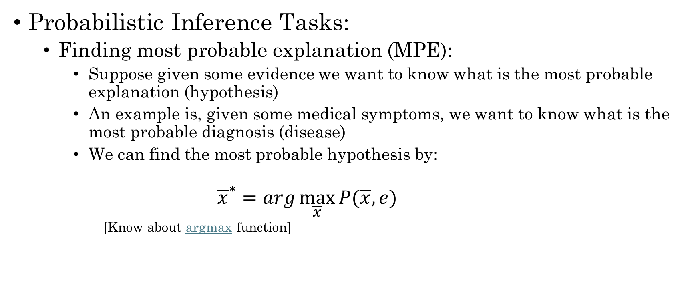
Application of Bayesian Network
Probabilistic Inference Tasks:
  Finding most probable explanation (MPE):
    Suppose given some evidence we want to know what is the most probable explanation (hypothesis)
    An example is, given some medical symptoms, we want to know what is the most probable diagnosis (disease)
    We can find the most probable hypothesis by:
      $${\overline{x}}^{∗}=arg\max_{\overline{x}}{P(\overline{x}, e)}$$
      [Know about argmax function]

Slide 32
Exercise
“A Lecturer’s Life.” Dr. Ann Nicholson spends 60% of her work time in her office. The rest of her work time is spent elsewhere. When Ann is in her office, half the time her light is off (when she is trying to hide from students and get research done). When she is not in her office, she leaves her light on only 5% of the time. 80% of the time she is in her office, Ann is logged onto the computer. Because she sometimes logs onto the computer from home, 10% of the time she is not in her office, she is still logged onto the computer.
  Construct a Bayesian network to represent the “Lecturer’s Life” scenario just described.
  Suppose a student checks Dr. Nicholson’s login status and sees that she is logged on. What effect does this have on the student’s belief that Dr. Nicholson’s light is on?

Slide 33
Exercise
“Jason the Juggler.” Jason, the robot juggler, drops balls quite often when its battery is low. In previous trials, it has been determined that when its battery is low it will drop the ball 9 times out of 10. On the other hand, when its battery is not low, the chance that it drops a ball is much lower, about 1 in 100. The battery was recharged recently, so there is only a 5% chance that the battery is low. Another robot, Olga the observer, reports on whether or not Jason has dropped the ball. Unfortunately, Olga’s vision system is somewhat unreliable. Based on information from Olga, the task is to represent and draw inferences about whether the battery is low depending on how well Jason is juggling.
  Construct a Bayesian network to represent the problem.
  Which probability tables show where the information on how Jason’s success is related to the battery level, and Olga’s observational accuracy, are encoded in the network?

Slide 34
Thanks

